Slide 1
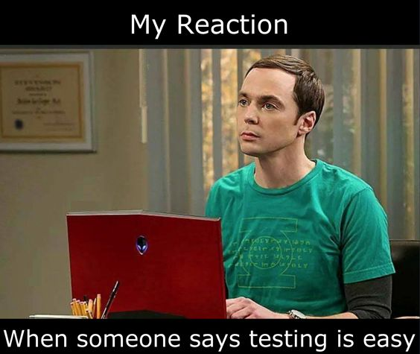
Introduction to
Unit Tests

Slide 2
Agenda
Motivation
Case study
Nunit
Basic parts of a unit tests
What does a unit test look like?
Exercises (Halloween style)
Testing and pitfalls

Slide 3
Manually test
class Program
{
static void Main(string[] args)
{
// Declare the unit-under-test
var uut = new Calculator();
// Test Add()
Console.WriteLine("Add({0}, {1}) = {2}", 3.5, 2.5, uut.Add(3.5, 2.5));
Console.WriteLine("Add({0}, {1}) = {2}", -3.5, 2.5, uut.Add(-3.5, 2.5));
Console.WriteLine("Add({0}, {1}) = {2}", -3.5, -2.5, uut.Add(-3.5, -2.5));
// Test Subtract()
Console.WriteLine("Subtract({0}, {1}) = {2}", 3.5, 2.5, uut.Subtract(3.5, 2.5));
Console.WriteLine("Subtract({0}, {1}) = {2}", -3.5, 2.5, uut.Subtract(-3.5, 2.5));
Console.WriteLine("Subtract({0}, {1}) = {2}", -3.5, -2.5, uut.Subtract(-3.5, -2.5));
// Test Multiply()
Console.WriteLine("Multiply({0}, {1}) = {2}", 3.5, 2.5, uut.Multiply(3.5, 2.5));
Console.WriteLine("Multiply({0}, {1}) = {2}", -3.5, 2.5, uut.Multiply(-3.5, 2.5));
Console.WriteLine("Multiply({0}, {1}) = {2}", -3.5, -2.5, uut.Multiply(-3.5, -2.5));
// Test Power()
Console.WriteLine("Power({0}, {1}) = {2}", 2.0, 3.0, uut.Power(2.0, 3.0));
Console.WriteLine("Power({0}, {1}) = {2}", -2.0, 3.0, uut.Power(-2.0, 3.0));
Console.WriteLine("Power({0}, {1}) = {2}", -2.0, -3.0, uut.Power(-2.0, -3.0));
}
}
public class Calculator {
public double Add(double a, double b) {
return a + b;
}
public double Subtract(double a, double b) {
return a - b;
}
public double Multiply(double a, double b) {
return a * b;
}
public double Power(double a, double b) {
return Math.Pow(a,b);
}
}

Slide 4
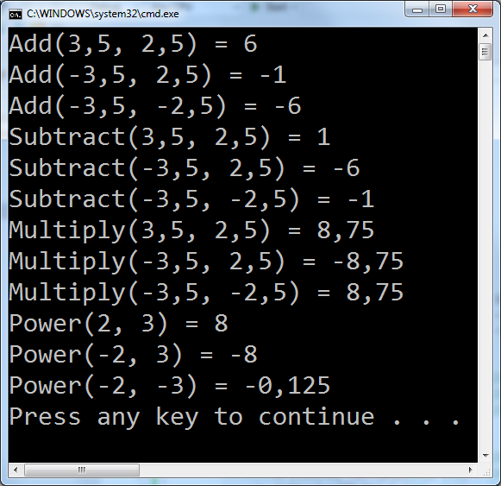
Validate result?

Slide 5


Slide 6


A unit tests
Unit-under-test
(UUT)
Expected result?
Input
Scenario
Output
Icons: FrICONiX.com
Notes:
A scenarios for a class

Slide 7
Scenario
Can be a requirement for the method/class
Different types:
Positive scenario (happy path)
Expected behavior
Negative scenario
Invalid / unexpected input
Edge case scenario
Boundary input
Exception scenario
Exception are thrown as expected

Slide 8
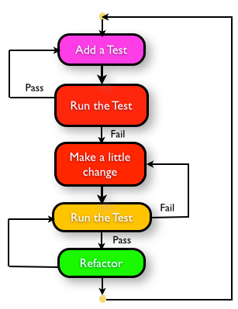
How to plan and execute test
Choose a scenario
Define input and output
Write the [Test]
Run the test*
Implement the business logic
Run the test**
Goto 1
* to test it fails
** to validate test succeeds

Slide 9
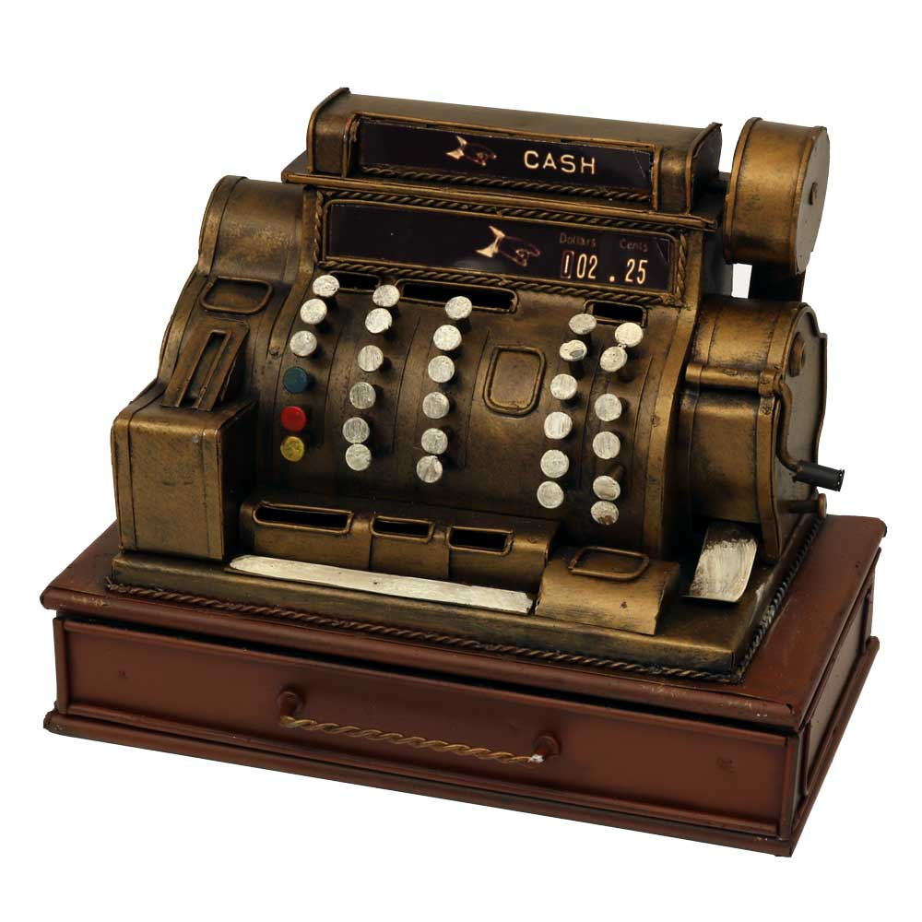
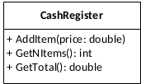
Demo: A cash register
We will implement and test a class CashRegister
Your turn to plan the tests: What test cases do we need for each of the class’ methods?
What is the scenario?
What is the test input?
What is the expected result?

Slide 10
Test also gives...
specifications built into the program
confidence in code
early error finding
decoupled system
better design

Slide 11
Your turn
For around 30 minutes do
Do ‘Exercise 1: Plan your tests’
Continue to ‘Exercise 2: Prepare workspace’ after complete Exercise 1.

Slide 12


Slide 13
Test framework
Gives:
Support for automation
Easy setup and removal
Good assertion constructs
Detailed test reports
Nice IDE integration
Testing styles

Slide 14
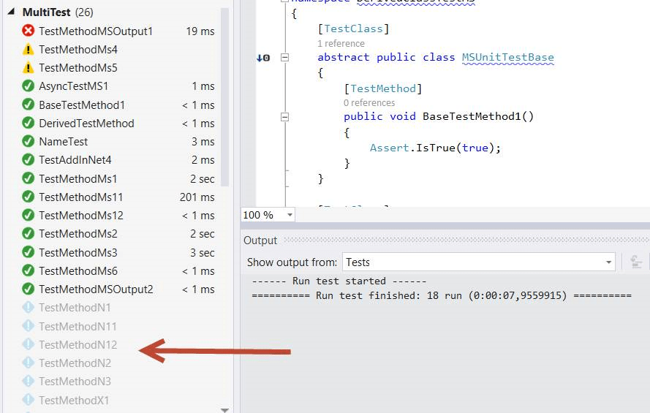
Automation / test report

Slide 15
Nunit example
[TestFixture]
public class UnitTest1 {
Calculator uut;
[SetUp]
public void Setup() {
uut = new Calculator();
}
[Test]
public void Test_AddMethod() {
double res = uut.Add(3.5, 2.5);
Assert.AreEqual(res, 6);
}
…
}

Slide 16
NUnit assertion - constraints
Constraint-based assert model
Assert.That(uut.Count, Is.EqualTo(10));
Actual state
Constraint with expected state
More constraints https://nunit.org/docs/2.5/constraintModel.html

Slide 17
NUnit assertion - constraints
Constraint-based assert model
Assert.That(uut.Count, Is.EqualTo(10));
Actual state
Constraint with expected state
Other constraints examples - many more exists
Assert.That(uut.Count, Is.GreaterThan(3));
Assert.That(myString, Is.EqualTo("Hello"));
Assert.That(array, Has.Exactly(3).LessThan(100));
Assert.That(() => myFailingMethod(), Throws.TypeOf<Exception>()
More constraints https://nunit.org/docs/2.5/constraintModel.html
Notes:
Assert.That – throws not tested

Slide 18
Test framework
Assertions Different ways to compare expected and actual test results in a readable way
Test case Each test case - tests one specific, isolated aspect of the unit-under-test
Test fixture Collects test cases and helps with setup, teardown, etc.
Test runner Runs the tests and reports the result
Test reports Results of the tests run

Slide 19
Demo: A cash register
Let us implement the CashRegister and the TestFixture

Slide 20
Your turn
Exercises
Note: We summarize at the end of the lecture

Slide 21
Testing
and Pitfalls

Slide 22
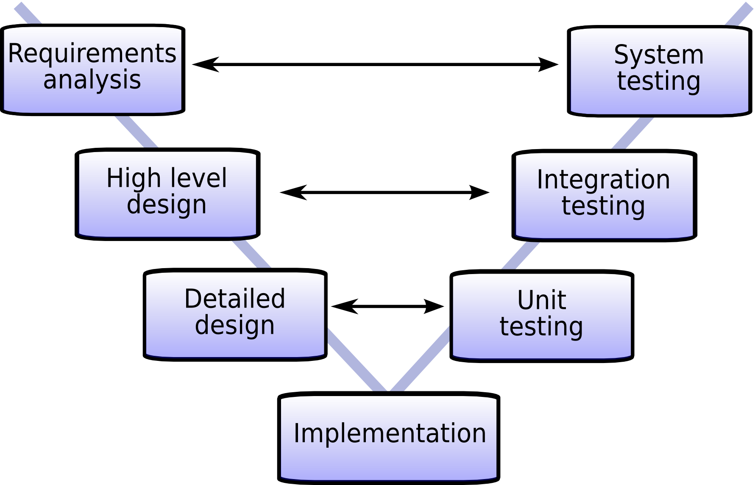

Slide 23
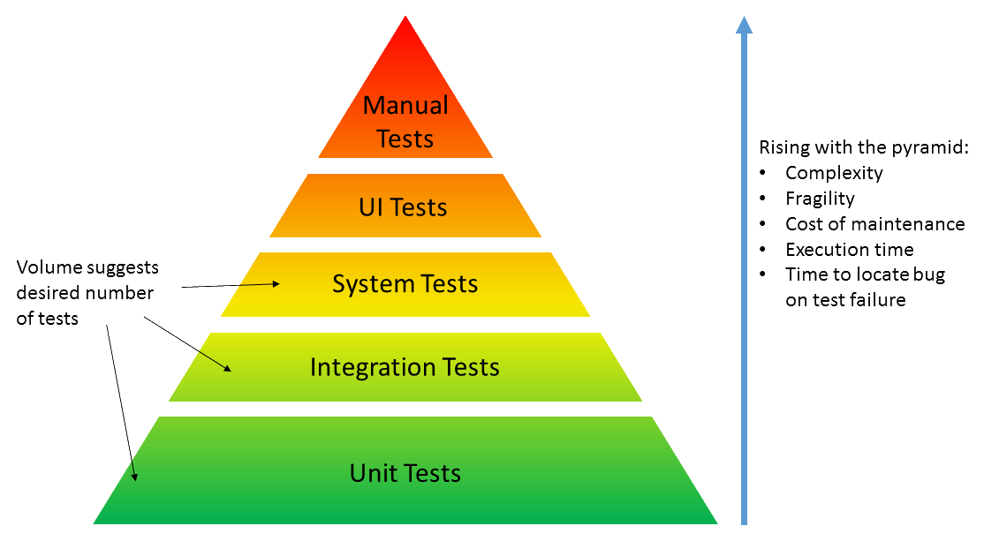
Why test? Why unit test?
Notes:
Speed
Security
Design

Slide 24
Pitfalls
The true unit test contains information about the design and behavior of UUT (Unit-under-test)
Do not make any assumptions about other parts

Slide 25
Pitfalls
The true unit test contains information about the design and behavior of UUT (Unit-under-test)
Do not make any assumptions about other parts
Integration-test do not tell anything about how the code base is broken down into units
Make assumptions about the whole system's behavior

Slide 26
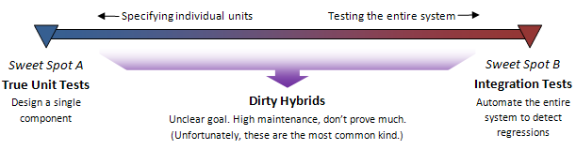
Pitfalls
The true unit test contains information about the design and behavior of UUT (Unit-under-test)
Do not make any assumptions about other parts
Integration-test do not tell anything about how the code base is broken down into units
Make assumptions about the whole system's behavior
In between
Small changes break unrelated test
Tests break - but the system works as “expected”

Slide 28
Reference
TDD: agilefaqs.com/services/training/test-driven-development
Dancing man: https://giphy.com

